Slide 1
Basis data klien server
Layout, Menu & Intent - Pertemuan 3 & 4

Slide 2
Layout

Slide 3
Relative & Linear layouts
Relative Layout

Slide 4
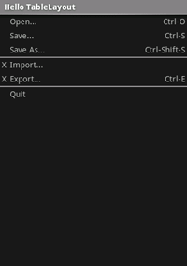
Table layouts
Table Layout
Like the HTML div tag
/* table.xml */
<?xml version=“1.0” encoding=“utf-8”?>
<TableLayout android:layout_width=“fill_parent”
android:layout_height=“fill_parent”
android:stretchColumns=“1”> <TableRow> <TextView android:layout_column=“1”
android:text=“Open...”
android:padding=“3dip” />
<TextView android:text=“Ctrl-O”
android:gravity=“right”
android:padding=“3dip” />
</TableRow>
</TableLayout>

Slide 5
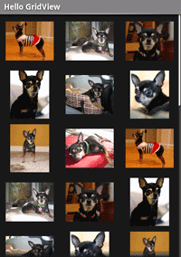
Grid View
Grid View
/* grid.xml */
<?xml version=“1.0” encoding=“utf-8”?>
<GridView
android:id=“@+id/gridview” android:layout_width=“fill_parent” android:layout_height=“fill_parent” android:columnWidth=“90dp” android:numColumns=“auto_fit”
android:verticalSpacing=“10dp” android:horizontalSpacing=“10dp”
android:stretchMode=“columnWidth” android:gravity=“center”
/>

Slide 6
Grid View
Grid View
/* GridExample.java */
public void onCreate(Bundle savedInstanceState) {
super.onCreate(savedInstanceState); setContentView(R.layout.grid); GridView gridview = (GridView) findViewById(R.id.gridview); gridview.setAdapter(new AdapterForGridView(this)); gridview.setOnItemClickListener(
new OnItemClickListener() { public void onItemClick(AdapterView<?> parent, View v,
int pos, long id) {
Toast.makeText(
GridPrimer.this, "" + pos, Toast.LENGTH_SHORT).show(); }});
}

Slide 7
Grid View
Grid View
/* AdapterForGridView.java */
public class AdapterForGridView extends BaseAdapter {
private Context mContext; public AdapterForGridView(Context c) { mContext = c; } public int getCount() { return mThumbIDs.length; } public Object getItem(int position) { return null;} public long getItemId(int position) { return 0; }
// bad getView implementation
public View getView(int pos, View convertView, ViewGroup parent) { ImageView imageView = new ImageView(mContext); imageView.setImageResource(mThumbIDs[pos]); return imageView;
} private Integer[] mThumbIDs =
{ R.drawable.img1, R.drawable.img2 /*...*/ };
}

Slide 8
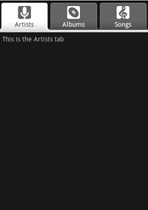
Tab Layout
Tab Layout
/* tab.xml */
<?xml version=“1.0” encoding=“utf-8”?>
<TabHost android:id=“@android:id/tabhost”
android:layout_width=“fill_parent”
android:layout_height=“fill_parent”>
<LinearLayout android:orientation=“vertical”
android:layout_width=“fill_parent”
android:layout_height=“fill_parent”>
<TabWidget android:id=“@android:id/tabs”
android:layout_width=“fill_parent”
android:layout_height=“wrap_content”/>
<FrameLayout
android:layout_width=“fill_parent”
android:layout_height=“fill_parent”/>
</LinearLayout>
</TabHost>

Slide 9
Tab Layout
Tab Layout
/* selector1.xml */
<?xml version=“1.0” encoding=“utf-8”?>
<selector xmlns:android=“http://schemas.android.com/apk/res/android”>
<!– Tab is selected -->
<item android:drawable=“@drawable/ic_tab_1_selected” android:state_selected=“true” />
<!– Tab not selected -->
<item android:drawable=“@drawable/ic_tab_1_not_selected” />
</selector>
/* selector2.xml */
/* selector3.xml */

Slide 10
Tab Layout
Tab Layout
/* Tab1.java */
public class Tab1 extends Activity {
public void onCreate(Bundle savedInstanceState) {
super.onCreate(savedInstanceState);
TextView textview = new TextView(this);
textview.setText(“This is the Artists tab”);
setContentView(textview);
}
}
/* Tab2.java */
/* Tab3.java */

Slide 11
Tab Layout
Tab Layout
/* TabExample.java */
public class TabExample extends TabActivity {
public void onCreate(Bundle savedInstanceState) {
super.onCreate(savedInstanceState);
setContentView(R.layout.tab);
TabHost tabHost = getTabHost();
//--- tab 1 ---
Intent intent = new Intent().setClass(this, Tab1.class);
TabHost.TabSpec spec = tabHost.newTabSpec(“tab1”).setIndicator(
“Artists”, getResources().getDrawable(R.drawable.selector1))
.setContent(intent);
tabHost.addTab(spec);
//--- tab 1 ---
tabHost.setCurrentTab(2);
}

Slide 12
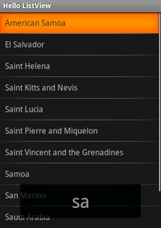
List View
List View
/* list_item.xml */
<?xml version=“1.0” encoding=“utf-8”?>
<TextView
android:layout_width=“fill_parent”
android:layout_height=“fill_parent”
android:padding=“10dp”
android:textSize=“16sp” />

Slide 13
List View
List View
/* ListViewExample.java */
public class ListViewExample extends ListActivity {
@Override
public void onCreate(Bundle savedInstanceState) { super.onCreate(savedInstanceState);
setListAdapter(new ArrayAdapter<String>(this, R.layout.list_item, COUNTRIES));
ListView lv = getListView();
lv.setTextFilterEnabled(true);
lv.setOnItemClickListener(new OnItemClickListener() { public void onItemClick(AdapterView<?> parent, View view, int position, long id) { Toast.makeText(getApplicationContext(),
((TextView) view).getText(), Toast.LENGTH_SHORT).show();
}});
}

Slide 14
Menu

Slide 15
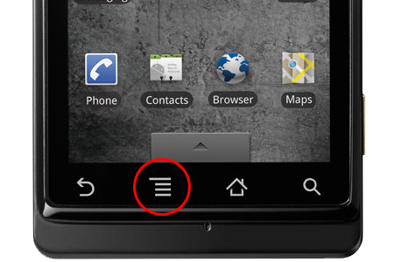
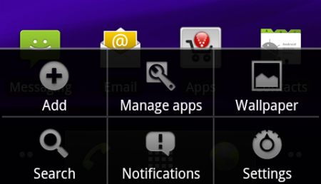

History
Beginning with Android 3.0 (API level 11), Android-powered devices are no longer required to provide a dedicated Menu button

Slide 16
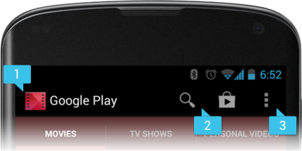
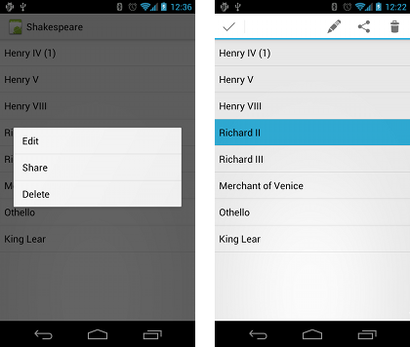
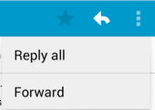
Types of Menus
http://developer.android.com/guide/topics/ui/menus.html
Three fundamental types of menus
Options menu and action bar
Context menu and contextual action mode
Popup menu

Slide 17
Intent

Slide 18
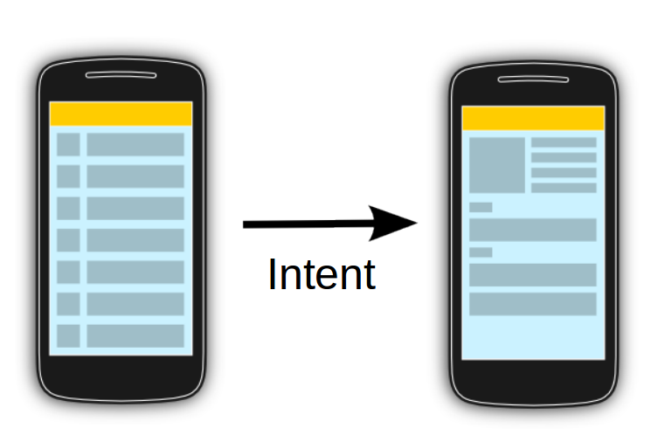
Intent
Allows communication between components
Message passing
Bundle
Activity 1
Activity 2

Slide 19
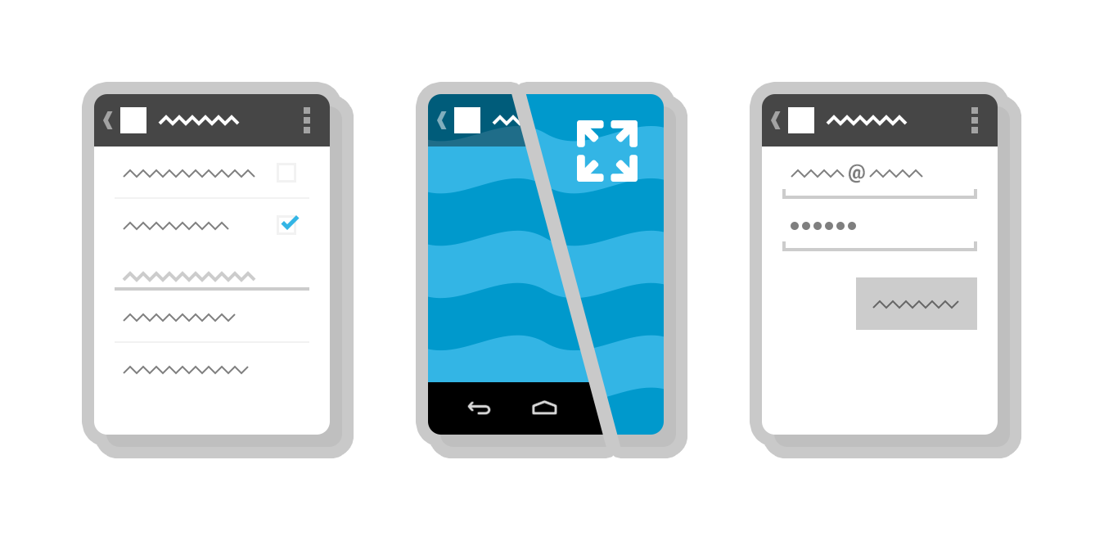
Intent
Three fundamental use-cases of Intent :
To start an activity
startActivity()
startActivityForResult()
To start a service
startService()
bindService()
To deliver a broadcast
sendBroadcast(),
sendOrderedBroadcast(), or
sendStickyBroadcast()

Slide 20
Intent Types

Slide 21
Explicit Intent
Implicit Intent
Intent Types

Slide 22
Explicit Intent

Slide 23
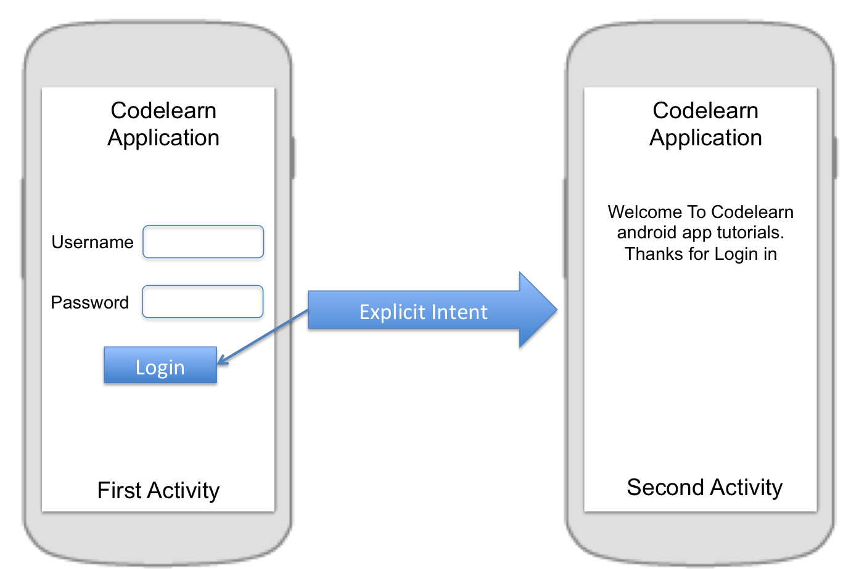
Intent intent = new Intent(FirstActivity.this, SecondActivity.class);
startActivity(intent);
Intent intent = new Intent(FirstActivity.this, SecondActivity.class);
intent.putExtra("Value1", "This value one for ActivityTwo ");
intent.putExtra("Value2", "This value two ActivityTwo");
startActivity(intent);

Slide 24
@Override
public void onCreate(Bundle savedInstanceState) {
super.onCreate(savedInstanceState);
setContentView(R.layout.main);
// Button listener
Button btnStart = (Button) findViewById(R.id.btn_start);
btnStart.setOnClickListener(new View.OnClickListener() {
public void onClick(View view) {
Intent intent =
new Intent(FirstActivity.this, SecondActivity.class);
startActivity(intent);
}
});
}

Slide 25
Implicit Intent

Slide 26
Implicit Intent
This type of intent is called an implicit intent because it does not specify the app component to start, but instead specifies an action and provides some data with which to perform the action.

Slide 27
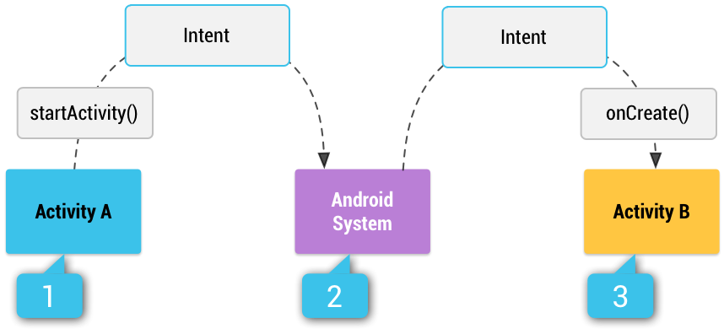
How an implicit intent is delivered through the system to start another activity

Slide 28
Activity A creates an Intent with an action description and passes it to startActivity().
The Android System searches all apps for an intent filter that matches the intent. When a match is found,
the system starts the matching activity (Activity B) by invoking its onCreate() method and passing it the Intent.

Slide 29
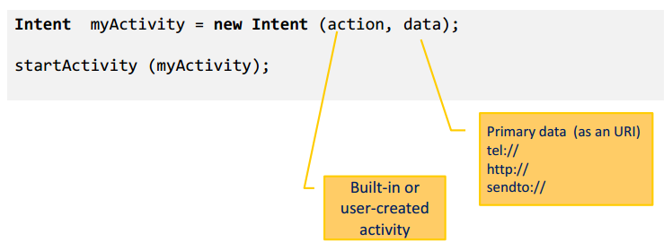
Implicit Intent Structure
The main arguments of an Intent are:
Action : The built-in action to be performed, such as ACTION_VIEW, ACTION_EDIT, ACTION_MAIN, …or user-created-activity
Data : The primary data to operate on, such as a phone number to be called (expressed as a Uri)

Slide 30
Intent Data Example
Action | Data
ACTION_DIAL | tel:081298419869
ACTION_CALL | tel:081298419869
ACTION_VIEW | http://www.diploma.ipb.ac.id
ACTION_VIEW | geo:-6.590056,106.80581499999994 ?z=19
ACTION_EDIT | content://contacts/people/2
ACTION_VIEW | content://contacts/people/
http://developer.android.com/guide/components/intents-common.html

Slide 31







Common Intent
Alarm Clock
Calendar
Camera
Contacts/People App
Email
File Storage
Maps
Music or Video
Phone
Settings
Text Messaging
Web Browser
http://developer.android.com/guide/components/intents-common.html

Slide 32
Manifest Permission
Action | Permission
PHONE CALL | android.permission.CALL_PHONE
ALARM | com.android.alarm.permission.SET_ALARM
INTERNET | android.permission.INTERNET
CALENDAR | android.permission.READ_CALENDAR
CONTACT | android.permission.READ_CONTACTS
CAMERA | android.permission.CAMERA
SMS | android.permission.READ_SMS android.permission.SEND_SMS
http://developer.android.com/reference/android/Manifest.permission.html

Slide 33
Thank you
Andika Sundawijaya
sundawijaya@gmail.com

